Slide 1

Welcome to MATLAB

Slide 2
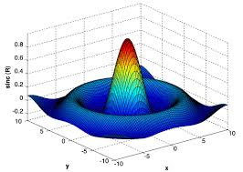

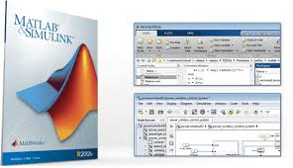

Slide 3
What is MATLAB?
Matlab = Matrix Laboratory
A software environment for interactive numerical computations
Examples:
  Matrix computations and linear algebra
  Solving nonlinear equations
  Numerical solution of differential equations
  Mathematical optimization
  Statistics and data analysis
  Signal processing
  Modelling of dynamical systems
  Solving partial differential equations
  Simulation of engineering systems

Slide 4
Why MATLAB – Why in ECE?
Core Programming language for Electronics and Communication system design
Popular tool used for engineering research after C (Includes embedded C), Java
Lot of Job opportunities in india and abroad

Slide 5
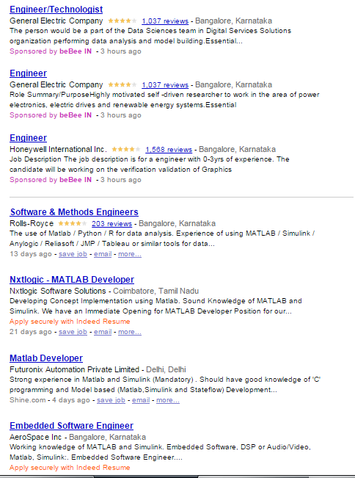
Job Opportunities

Slide 6
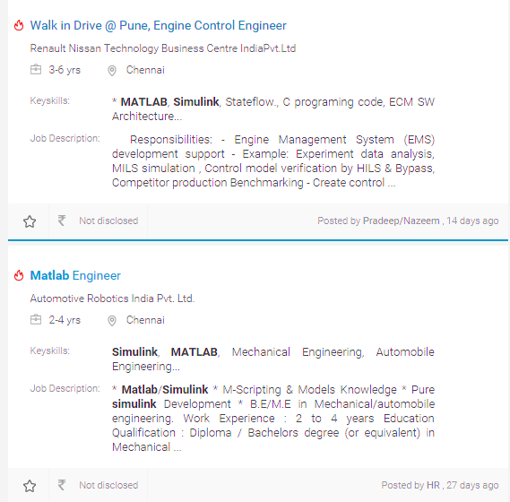
Job Opportunities

Slide 7
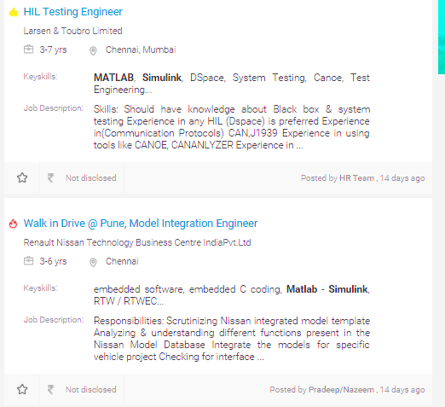
Job Opportunities

Slide 8
Job Opportunities
Positions You can Get
Major Companies
System Engineer
Design Engineer
MATLAB developer
Research Analyst
Control Engineer
Simulink Developer
Test Engineer
Data Analyst
Bio informatics scientist
Control Engineer
Amazon, Alcatel Lucent
GE, L&T, Vestas, Mu sigma
AT&T, Ericsson, 3GPP
Renault & Nissan
ATMEL, INTEL, ARM
Infosys, Wipro, TATA ELXi, Accenture
Boeing, Airbus
Robert Bose etc…

Slide 9
MATLAB Toolboxes
MATLAB has a number of add-on software modules, called toolboxes, that perform more specialized computations.
Signal & Image Processing
Signal Processing- Image Processing Communications - System Identification - Wavelet Filter Design
Communication
  Analog and Digital Modulation
  Source and Channel Coding
  Channel Modeling and RF Impairments
  Equalization and Synchronization
  Stream Processing in MATLAB and Simulink
  Implementing a Communications System
More than 60 toolboxes!

Slide 10
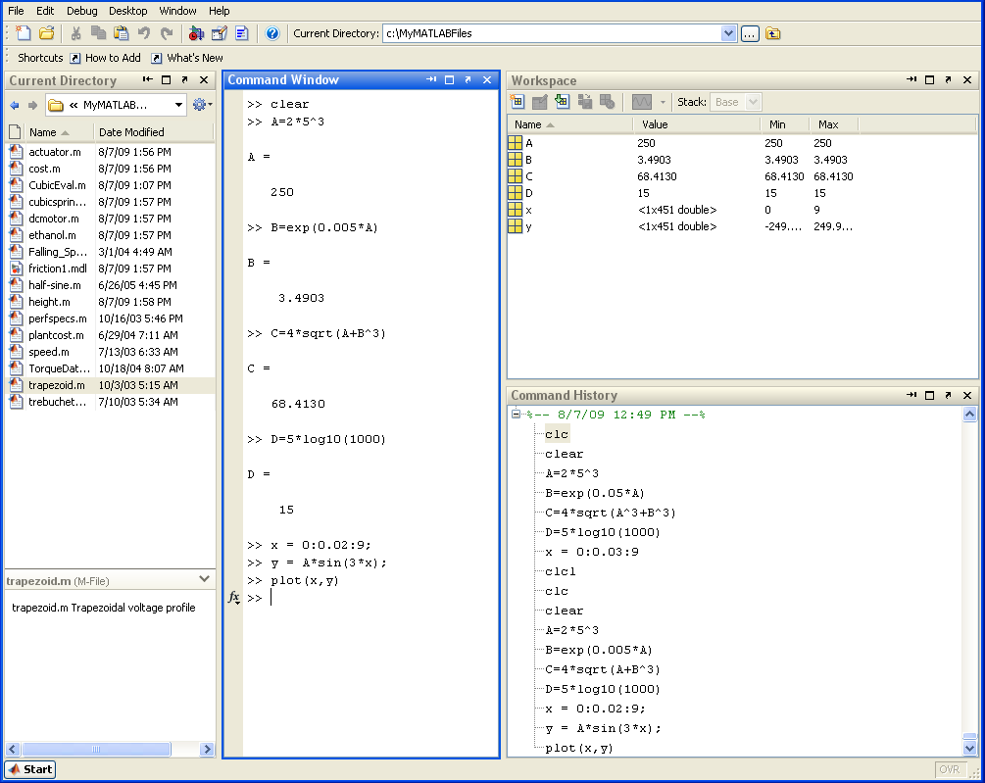
Matlab Desktop (<=R2012a)

Slide 11
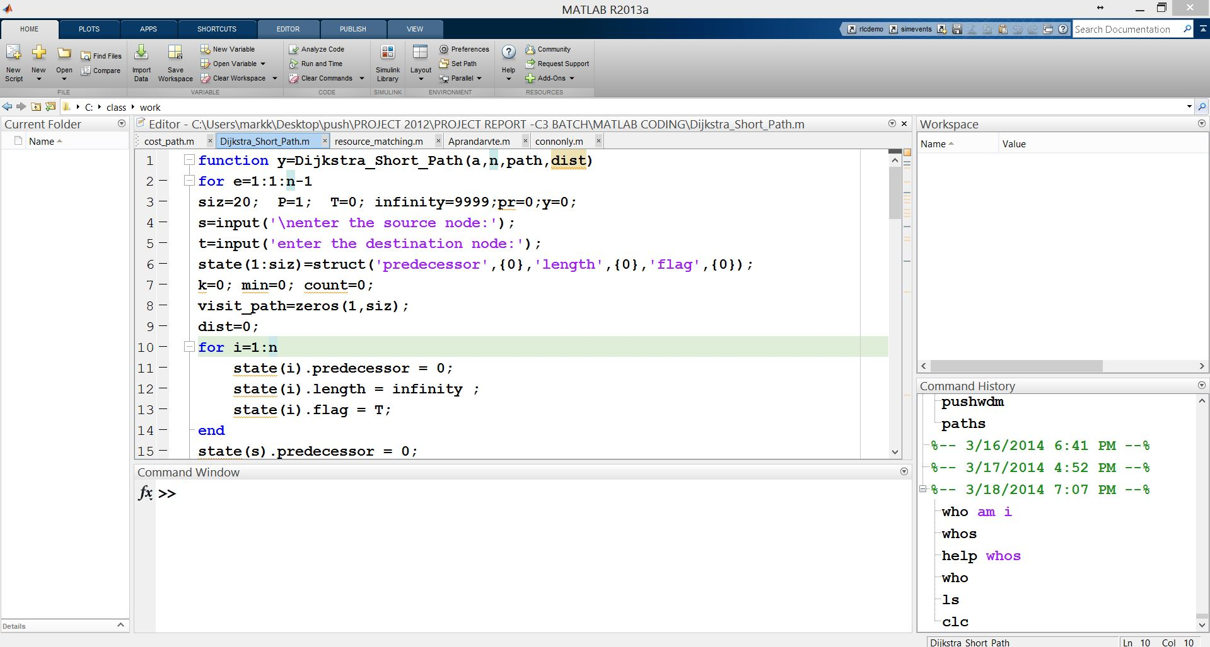
Matlab Desktop (>=R2012b)

Slide 12
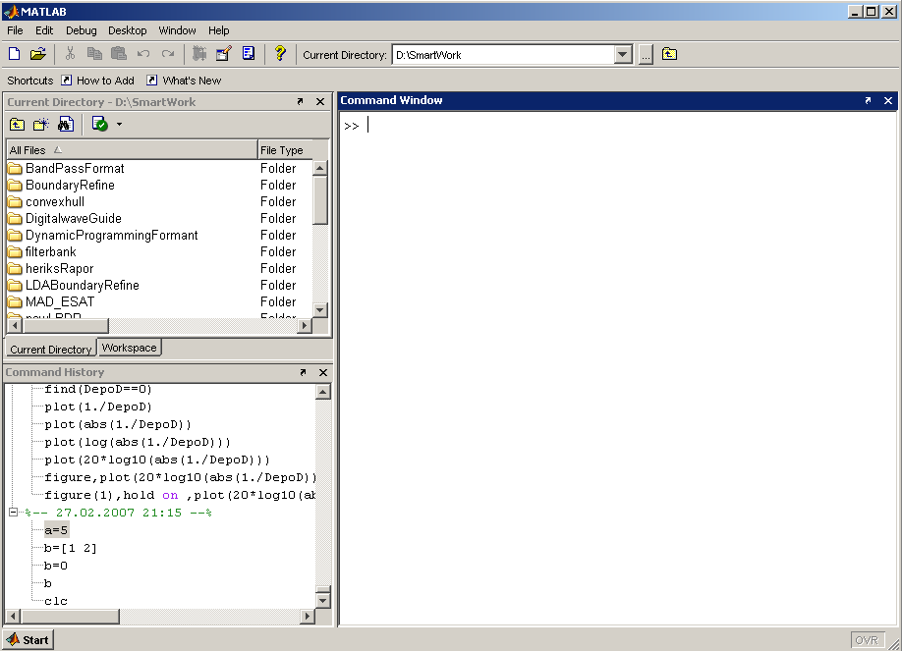
Matlab Screen
Command Window
  type commands
Current Directory
  View folders and m-files
Workspace
  View program variables
  Double click on a variable
  to see it in the Array Editor
Command History
  view past commands
  save a whole session
  using diary

Slide 13
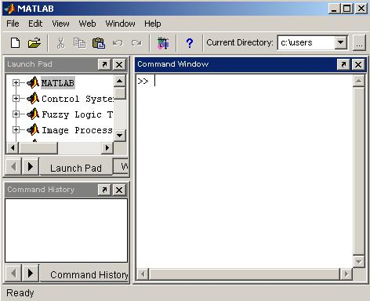
MATLAB
Command
Window

Slide 14
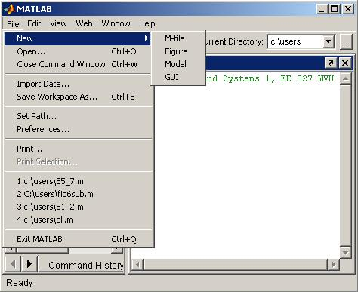
File

Slide 15
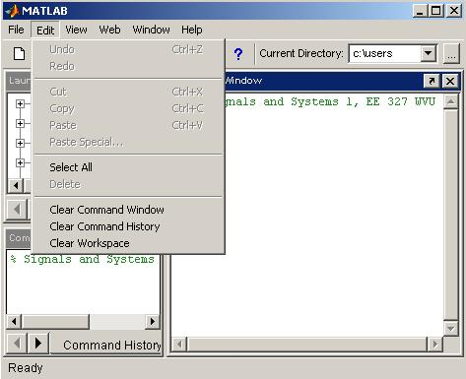
Edit

Slide 16
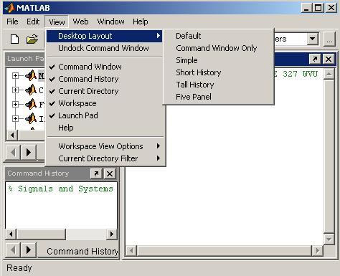
View

Slide 17
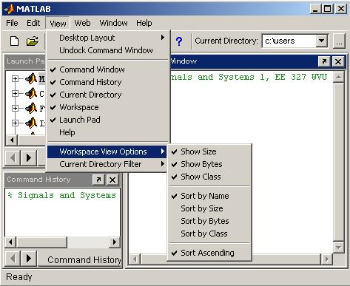
View

Slide 18
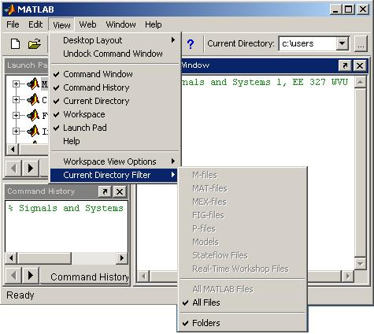
View

Slide 19
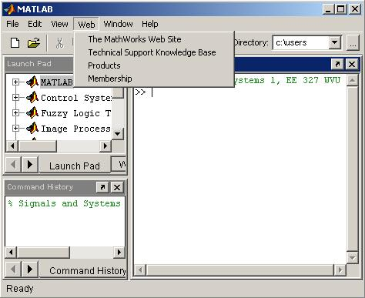
Web

Slide 20
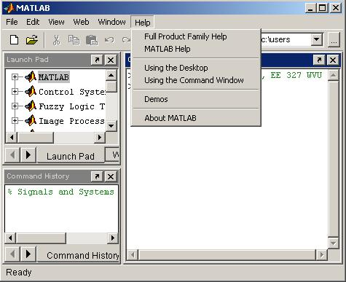
Help

Slide 21
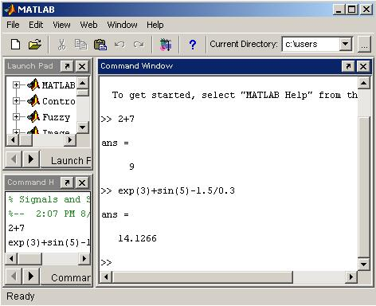

Slide 22
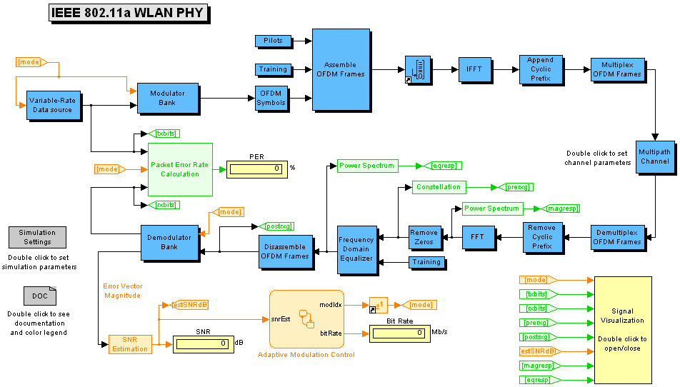
Simulink
Simulink - a package for modeling dynamic systems
Notes:
Simulink is a program that runs as a companion to MATLAB, these programs are developed and marketed by the MathWorks, Inc. Simulink and MATLAB form a package that serves as a vehicle for modeling dynamic systems. Simulink provides a graphical user interface (GUI) that is used in building block diagrams, performing simulations, as well as analyzing results.

Slide 23
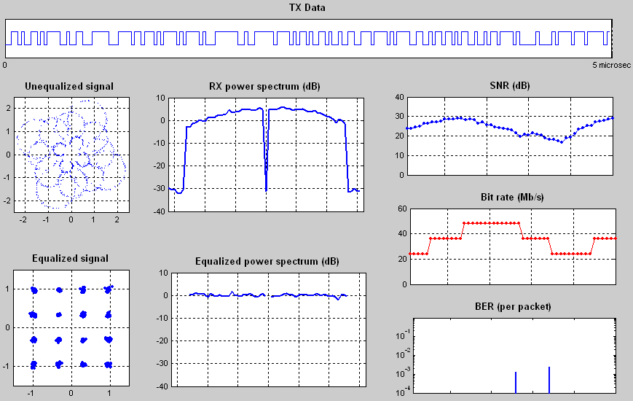
Simulink (cont‘d)
Analyzing results:
Notes:
Simulink is a program that runs as a companion to MATLAB, these programs are developed and marketed by the MathWorks, Inc. Simulink and MATLAB form a package that serves as a vehicle for modeling dynamic systems. Simulink provides a graphical user interface (GUI) that is used in building block diagrams, performing simulations, as well as analyzing results.

Slide 24
Construction
Core functionality: compiled C-routines
Most functionality is given as m-files, grouped into toolboxes
  m-files contain source code, can be copied and altered
  m-files are platform independent (PC, Unix/Linux, MAC)
Simulation of dynamical systems is performed in Simulink

